Slide 1
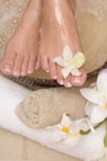
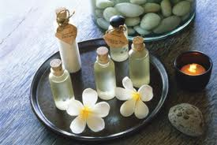
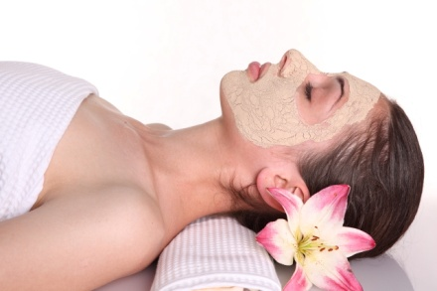
Bethune Spa Services
Body Wraps
Body Wrap A
Invigorating body exfoliation polishes away dry skin with nourishing essential oils and salt. The treatment will detoxify your body relaxed in a steam bag, while you can enjoy a scalp massage.
Body Wrap B
An experience of algae wrap of smooth, silky mud that will detoxify and revitalize the skin. The content of trace elements and minerals will help to stimulate the skin metabolism, leaving the skin with a healthy and natural glow.
Spa Pedicure
French Pedicure
An exfoliation or refreshing foot mask, and paraffin will be also included in a French pedicure.
Spa French Pedicure
Based on Spa pedicure, foot bath with particular herbal essences will also be included to improve foot circulation and for relaxation.
Facial Treatments
Basic Facial
A deep cleansing, exfoliation and vitamin packed finish will restore your natural radiant skin.
Galvanic Facial
Anti-aging, reducing wrinkles, lifting and tightening the skin, improving skin circulation, hydration and boosting cell renewal by applying recommended pearl, ginseng or other herbal power. The treatment can be combined with other facial for optimal results.
Deluxe Facial
This classic facial uses all natural plant and essential oil extracts and relates to skin specific needs. This experience is complete with a deep cleanse, exfoliation, relaxing massage and absolute nourishment.

