Slide 1


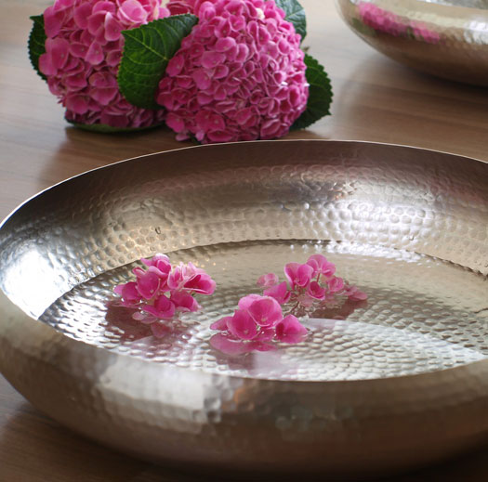
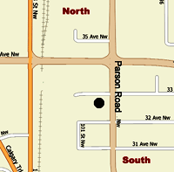
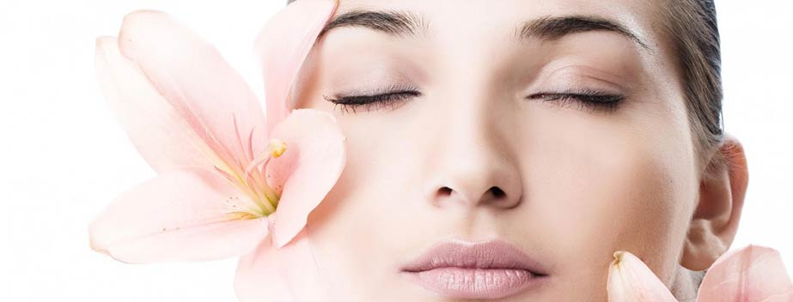
Body Wraps
Body Wrap A $50
Body Wrap B $60
Spa Pedicure
French Pedicure $38
Spa French Pedicure $48
Facial Treatments
Basic Facial $58
Galvanic Facial $68
Deluxe facial $78
Special Packages
You may choose a Spa package by combining three or more services to receive around 10% off discounts. All packages are for per person, to be completed on the same day. Please expect time for some relaxation in between services.
Body Polish $108
Including a body wrap A & relaxing massage
Spa Package $108
Including a deep cleansing facial & Spa pedicure
Stress Reliever $128
Including a cleansing facial, relaxing body massage & pedicure
Main Clinic
3220 – 99 St. (Parsons Rd.)
Edmonton, Alberta T6N 1M2
Tel: ( 780 ) 461 6668
Fax:( 780 ) 461 6366
www.bethuneacupuncture.com
Sub-Clinic
Whitecourt: (780) 461-6668
Lloydminister: (780) 461-6668
Lac Labiche: Louise (780) 623-7041
Business Hours
Mon - Fri: 9 AM- 7 PM
Sat – Sun: 9 AM- 4 PM
34 Ave.
99 St.
Bethune Center
You can take Bus 70, drop off at 32 Ave.

